Slide 1
All Staff Monthly Meeting Clinical Informatics and Data Management Office (CIDMO)
Join Skype Meeting
Join by phone
844-358-7954,,529279084# (North) English (United States)
844-210-0201,,529279084# (North) English (United States)
844-894-0415,,529279084# (North) English (United States)
Conference ID: 529279084
September 10, 2019 @ 3:00 p.m.

Slide 2
Agenda
Opening Remarks/CIDMO Updates -- Jonathan Nebeker (10 mins)
Staff Acknowledgements/Announcements –
New Staff: Kellie A. Harris & Dawnella V. Sturdivant
Service Awards : Anthoney Gilyard – 40 years
OHI Town Hall: September 24, 2019 @ 1:00 p.m.
Clinical Informatics and Data Management Office – Re-introduced (30 mins)
Jonathan Nebeker
Questions & Answers (10 mins)
Closing Remarks
Kellie Condon – Facilitator

Slide 3
Announcement
Effective immediately Jonathan R. Nebeker has been appointed as the Interim Director of Clinical Informatics and Data Management Office (CIDMO)
Please use the following signature block:
Jonathan R. Nebeker, MD, MS
Interim Director, CIDMO

Slide 4
Welcome New Staff
Informatics Patient Safety
Kellie A. Harris 8/18/2019
Dawnella Sturdivant 9/1/2019
Official introductions to follow but,
please introduce yourself and welcome
Kellie and Dawnella should your paths cross.

Slide 5
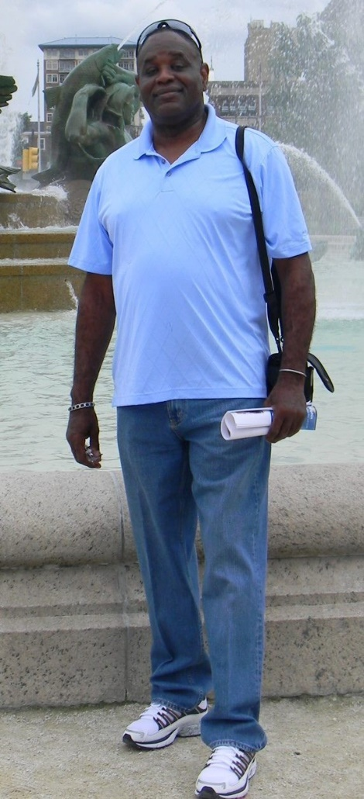
Staff Announcements – Service Awards
Anthoney “Toney” Gilyard – 40-Year Service Award
Mr. Gilyard serves as a Supervisory Program Manager in the DoD/VA Interagency Program Office. As the VHA business manager of major interagency health data sharing initiatives (BHIE/LDSI, CHDR, DAS, VLER, and VistA Imaging VA/DoD Sharing). He also, reviews and support projects that raises to the level of national importance and ultimately that influence Veterans Healthcare Administration and Department of Defense medical treatment facilities sharing of patient care information. As an IT SME Mr. Gilyard supports OIA HI HIS leadership with expert in-depth knowledge of the theories and practices of health IT data management and ability to formulate concepts, goals, objectives, trends, and methods used in the Project Management Body of Knowledge (PMBOK) as the base for all project management. Prior to his current position he was a Lead IT Specialist and Site Manager at the VA Health Care System in El Paso, Texas, where he Co-authored with DoD counterpart the local IT proposal and requirements for the integration of Lab Data Sharing Interoperability (LDSI) application for VA VistA and DOD Armed Forces Health Longitudinal Technology Application system (AHLTA) into a single infrastructure Medical system.
Toney’s civil service career began after serving 21 years in the U.S. Army (12/1974 to 8/1996) in which he served in all enlisted position within the branch from private to First Sergeant, Drill Sergeant, and Basic Non-Commission Office Training Course Senior instructor.

Slide 6
CIDMO - Announcements
Office of Health Informatics
“TOWN HALL”
September 24, 2019
1:00 – 2:30 p.m.
Dial-in Information: VANTS (audio) 1.800.767.1750 - Participant Code 47708# -
this is the only way to access the audio -and-
Visual Information: http://va-eerc-ees.adobeconnect.com/rf3agwxq2wi9/
Ask questions in advance or offer suggestions for future Town Hall topics via 10A7’s online Feedback Form: http://vaww.ehealth.va.gov/EHEALTH/feedback.asp.

Slide 7
Re-introducing:
Clinical Informatics and Data Management Office
(CIDMO)
Preparing for a new Fiscal Year
Notes:
Peter Drucker said that “the greatest danger in times of turbulence is not the turbulence – it is to act with yesterday’s logic.” It is with this sentiment that many of us have been transitioning from the former Health Informatics to Clinical Informatics and Data Management Office or CIDMO.
As we begin today’s all-staff call, I want to take this time to share with you the latest developments that include some new ways to organize the work that we do, redefine what we do, and better focus how our work positively impacts the 9 million veterans we serve and their many of thousands of care givers, providers and administrative support staff.

Slide 8


CIDMO’s Critical Difference to OHI and VHA
Supports behind the scenes information management:
To support a high-reliability, learning health organization
To focus on business practices that improve value to Veterans and those that care for them
By ensuring a standardized-system across VHA
Provides expertise, education, and new tools in the areas of:
Health Informatics
Clinical Informatics
Data Management and Analysis
Works as an integrated team to advance a consistent standard of care; provide reliability through standardization and surveillance; and promote interoperability and seamless care
Jonathan R. Nebeker, MD
Interim Director, CIDMO
I’m excited to lead this new organization, called CIDMO, which I see as a “behind-the- operation” that helps VHA providers and staff meet the mission of serving Veteran patients more efficiently and overall improving health care delivery.
Notes:
So let me share with you a bit of my personal views about why and how I believe CIDMO will make a critical difference in VA and VHA as we transition in Fiscal Year 2020.
As the lead for health and medical informatics in VHA, we have refocused ourselves around key definitions and scopes of practice:
Health informatics to better inform quality and use of health care, bridging the expertise gap between information technology and health care to make both more effective;
Clinical informatics to focus on better information and use for clinical operations throughout the agency;
Data Management and Analysis to focus on foundational solutions and methods along the entire continuum of data-and-analytics, which comprises data acquisition, organization, analysis, and deliver;
We’ll accomplish this in a variety of way, but focusing on some key indicators:
CIDMO will provide essential products and services to promote reliability and learning throughout VHA;
Provide standardization and surveillance practices;
Enhance learning opportunities; and
Lead the promotion of interoperability and seamless care

Slide 9
A Strategic Renewal
This is not a big reorganization. You mostly likely will sit in the same place as you do now.
It’s about refocusing the work to align with current VHA priorities and increase productivity.
What’s in it for you?
More predictable work and funding after an initial readjustment period.
More satisfaction seeing work improve lives of Veterans and staff.
More opportunities for individual growth (training, collaborative work)

Slide 10
Background: Mission, Vision, Principles
Mission
Improve the lives of Veterans and health care staff with better information and solutions for better decisions and workflows
3-year
Vision
Recognized for outstanding service that helps realize the VHA high-reliability learning organization through user-centered standardization of health information, clinical processes, and technologies
Guiding Principles
Faster and more value to field; VA and national leadership; Delivering complete solutions; Customer satisfaction; Teaming with clinical and IT programs; Standardized best informatics practices
Notes:
Consider this transition our strategic renewal.
As we move from Fiscal Year 2019 to Fiscal Year 2020, I’m pleased to introduce you to CIDMO’s Mission, Vision, and Guiding Principles – these have evolved over time, with the input from many of you and certainly with the partnership of your Executive Directors and Deputy Directors.
Our work will transition to mission-oriented projects that are about providing customer-value – meaning how do we support patient care or the management of health care operations.
This retooling allows us to work in a more integrated way, improving people, process, and tools from internal to external stakeholders;
REVIEW MISSION, VISION, AND GUIDING PRINCIPLES.

Slide 11
Background: Main Goals
1
Support highly reliable learning health care system
2
Improve productivity through co-managed programs
3
Build CIDMO brand
4
Improve CIDMO internal operations

Slide 12
Notional Divisions (not signed)
Notes:
Some teams have been renamed to be more descriptive.

Slide 13
Data Management and Analytics
Not a competitor to but an enabler of Population Health and RAPID.
Focuses on foundational capabilities for the data & analytics continuum: data acquisition, organization, analysis, and delivery.
Also uses CS-based analytical methods such as machine learning.
Work with ORNL and DoD is key.

Slide 14
Factory Analogy
Assembly line creates the product.
Many workstations on the line. Technical services and products applied at each workstations.
People are the main “tools” and need “tuning.”
Off the line on the floor, other teams do things that help the line operate efficiently.
Productivity is clearly defined at the end.

Slide 15
Literally refocusing work
Work Categories
Mission work: This is our business. Maximize!
Internal work: Improves mission work but is not directly productive. Optimize.
Changes: Affects work. Manage.
Unplanned work: Drains resources. Routinize.
Line of sight to value
Chain of cause and effect to generate benefits.
Each step on the chain must not be left to chance.

Slide 16
Strengthening Cooperative Relationships
CIDMO to operate more like a Portfolio Management Office.
The Director’s Office performs many portfolio functions.
Each Division is a program office, some with multiple programs (assembly lines)
Clear accountability and responsibility for production. You know your span of control.

Slide 17
Three Categories of Activities
Program activities (Divisions run)
Signature Products
Other technical services and products
Portfolio activities (Director’s office mostly runs)

Slide 18
Signature Products
Signature Products are lifecycle packages that are complete in three significant ways.
has a complete, specified, and resourced system/product lifecycle;
benefited in each stage of the lifecycle from all applicable informatics services (e.g., human factors, process engineering, terminology, knowledge representations, change management); and
addressed all dependencies to realize mission value including those from technical, end-user, and policy perspectives.

Slide 19
Program Activities |  | Portfolio Activities
Signature Products | Technical Services and Products
Software focus Clinical (HSM) BarCode, JLV, Apps, Clinical platforms (FIS) CPRS Partnered-Data-Exchange (VHIE) Data Management (DMA) Advanced Analytics (DMA) Configuration focus Health Practice Patterns (FIS) Data or analytical pipelines (DMA) Workforce focus Design, deployment, and configuration teams (FIS) Standards focus Community standards (KBS) | Process/System Re-engineering (HFE*) Human centered design and evaluation (HFE*) HIT solution implementation (FIS*) Curricula for training and competencies (FIS*) VistA data and package maintenance (FIS) Issue resolution for clinical IT solutions (FIS) Federal informatics policy coordination (IHI*) VA-DoD joint program support (IHI*) Safety surveillance and remediation (IPS*) Terminology-based data standardization (KBS*) Knowledge representation (KBS*) Informatics Architecture (KBS) Health data organization (DMA*, KBS, VHIE) | Internally facing Budget and human-resource management including cultural transformation (Operations team* administrative competencies) Strategy, architecture, and innovations Standards and Value management (IVM Team* project-management competencies) Technical competency and standards (by divisions starred in the Program Activities column) Externally facing Strategic informatics engagements and communications (Director’s Office* communications competencies)
Notes:
While the organizational units are critical, it’s important to understand the CIDMO is largely organized as a portfolio of programs with divisions roughly corresponding to programs and the Director’s Office providing most portfolio management functions.
Program activities break down into Signature Products and other technical services and products. Because of the special characteristics of Signature Products, it is useful to think of three different types of activities in CIDMO: portfolio activities, Signature Products, and other technical services and products.
The Table 1 presented here breaks down these activities and indicates accountable CIDMO divisions. Activities not listed in this table require special justification for funding. (If you think we are missing an activity, bring it to the attention of your division director for consideration of adding to the list.) A more completed and detailed description of each of these will be provided to you by your division leaders after this meeting.
CIDMO’s Signature Products directly enhance clinical workflows and have complete, resourced lifecycles. CIDMO will focus resources on Signature Products. Other program activities produce artifacts and technical services for Signature Products and for customers outside of CIDMO.
Portfolio activities help maximize productivity of the other activities (within constraints of regulations and policy) and provide transparency up the chain of command. Note that divisions are responsible for the portfolio function of managing technical competencies and standards.

Slide 20
The CIDMO Flow
Notes:
Finally, I’d like to conclude by sharing with you the following diagram, which depicts what I view as the High-level Functional Components of CIDMO service/product flows and customers.
Internal CIDMO activity and work consumption indicated in dark blue (darkest color).
Consumption by mission work and mission customers is indicated in orange (lighter color).
Collaborators and higher organizations are indicated in light blue (lightest color).
Work that does not flow directly to products and services that help health care customers is internal work, which should be optimized to maximize work that improves healthcare. The recursive arrow represents internal technical services and products that serve to maximize mission productivity.

Slide 21
Value
Setting up matrixed value management team
Measures costs, benefits
Makes the case to VA and VHA how our work makes a difference.
Every person on the team must understand:
What benefits the product or service is targeting.
How they and their team contribute help realize those benefits.
Every person on the team should think about how we can be more effective at providing value.

Slide 22
Questions/Discussion
What are your questions?
Any feedback?
Next steps:
Your Division directors will meet with you to further review the transition and proposed organization
You will receive a copy of the CIDMO Plan, a living document that will evolve over time; it is provisional in nature and subject to change
Effective October 1, 2019, CIDMO will be fully transitioned to this new organization.

Slide 23
Questions
Have a Question?
Request a Topic?
Make a Suggestion?
Make a Comment?
Please write your questions
into the Chat Box

Slide 24
SharePoint – POCs – Next Call
Slide Decks for All Staff Calls can be found on the following link:
https://vaww.vaco.portal.va.gov/sites/OHIA/HI/CIDMO%20All%20Staff%20Meeting/Forms/AllItems.aspx
Points of Contacts
Kellie Condon (Kellie.Condon@va.gov) (805) 868-2076
Dare Meadows (Dare.Meadows@va.gov) (706)733-0188 X6062
Next meeting: October 8, 2019 at 3:00 p.m.

